Slide 1
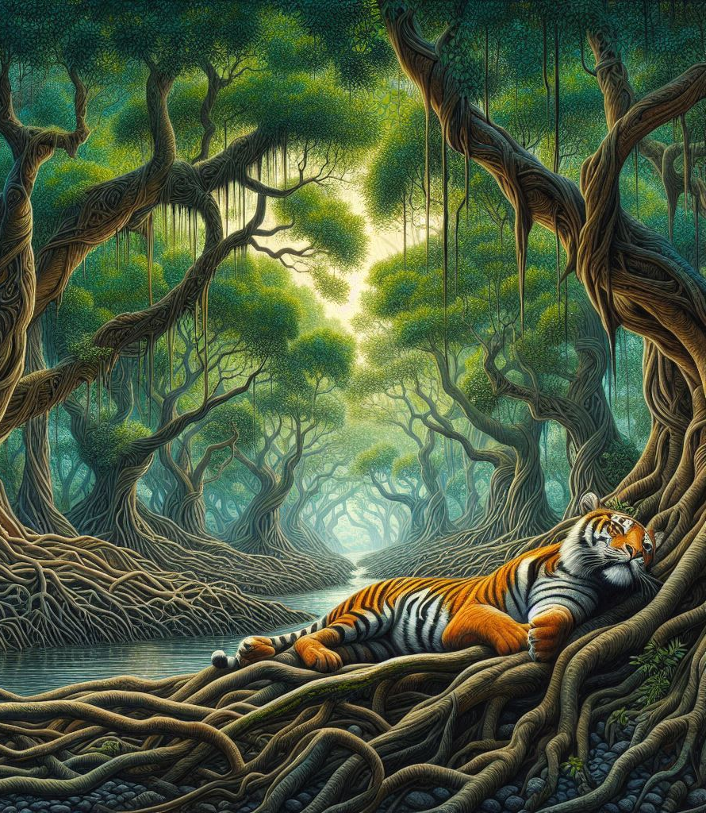
Sundarbans- An artistic interpretation.

Slide 2
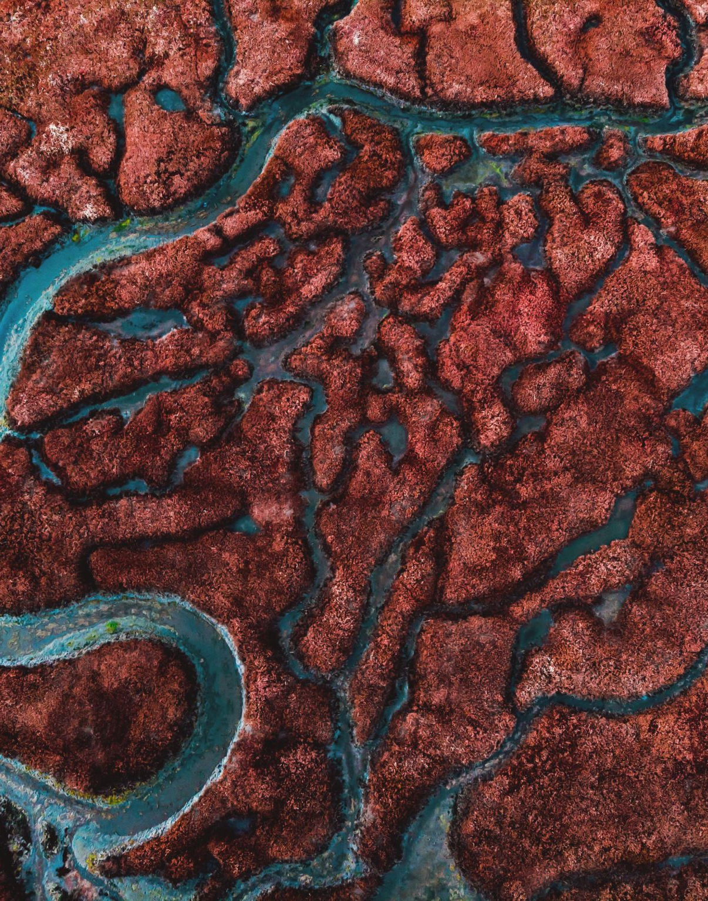
1) The mystic mangrove forests flowing through the Gangetic Delta
- Visual Art Depiction- Priyadarshi
- Storytelling- East India Dastangos

Slide 3
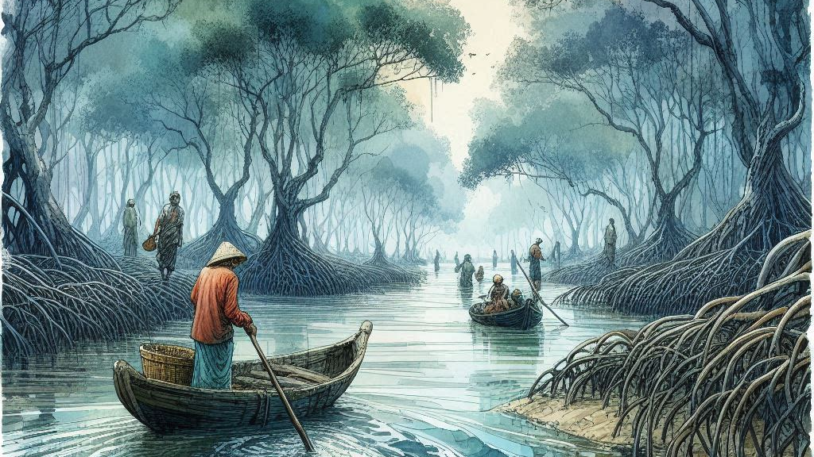

Slide 4
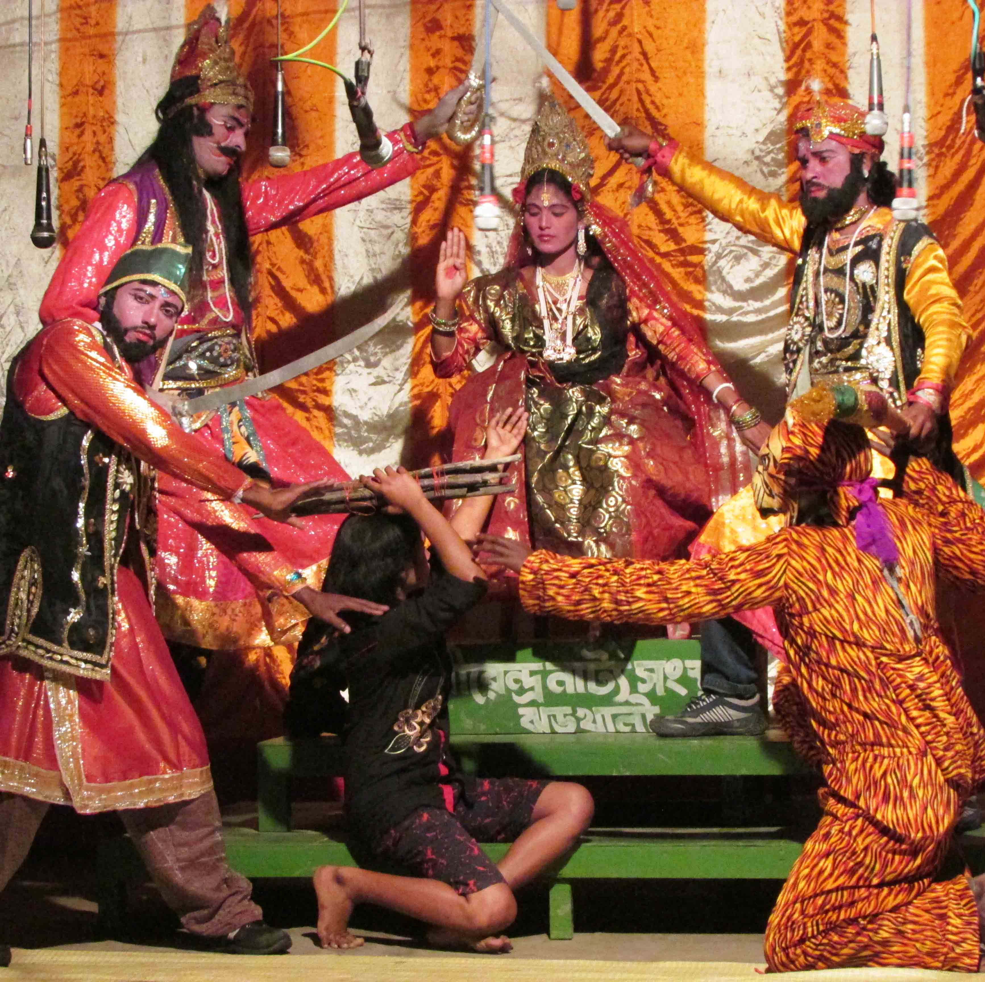
2) Faith and the Bonbibi
- Music and dance from the local artists and Swarnabha Gupta
- Storytelling- East India Dastangos

Slide 5
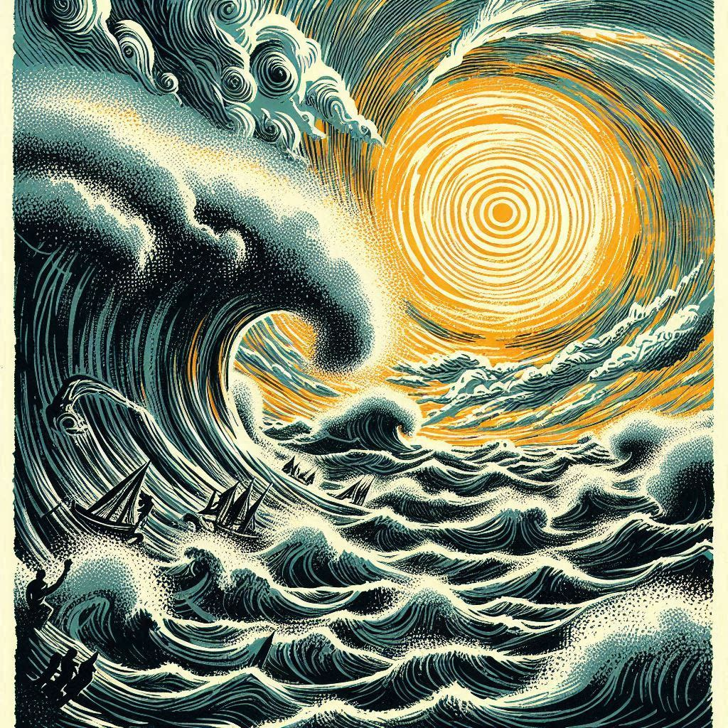
3) Cyclone and climate change in the Sundarbans
- Music and dance from the local artists
- Storytelling- East India Dastangos
- katha stitch work video presentation of communities

Slide 6
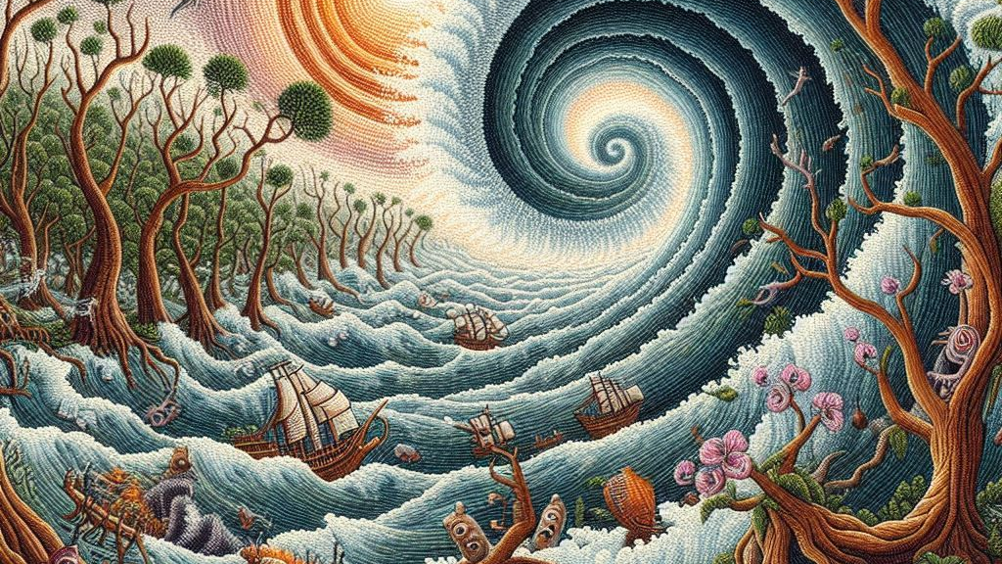

Slide 7
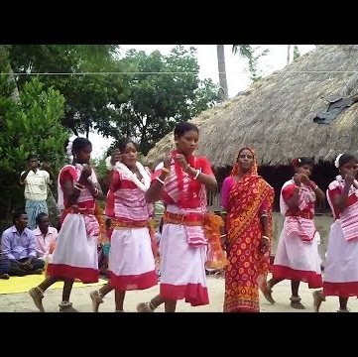
4) Building back better
-Dance – Radhika Mulay along side group santal dance
- Painting- Charolette Qin
Storytelling – East India Dastangos

Slide 8
